Slide 1

Predicting Bankruptcy & Detecting Money Laundering using Machine Learning
Presented by:
Aman Singh
Vishal Singh

Slide 2
Paper: Cognitive Modelling of Bankruptcy Risk
Objective: Predict company bankruptcy using machine learning
Dataset: US Company Bankruptcy Prediction Dataset (20 years of US company data from Kaggle)
Size: 78,682 instances, 21 attributes
Target Variable: status_label (alive: 1, failed: 0)
Models used:
Logistic Regression
K-Nearest Neighbors
Decision Tree
Support Vector Machine (Linear & RBF)
Neural Network (Model Excluded)
Random Forest

Slide 3
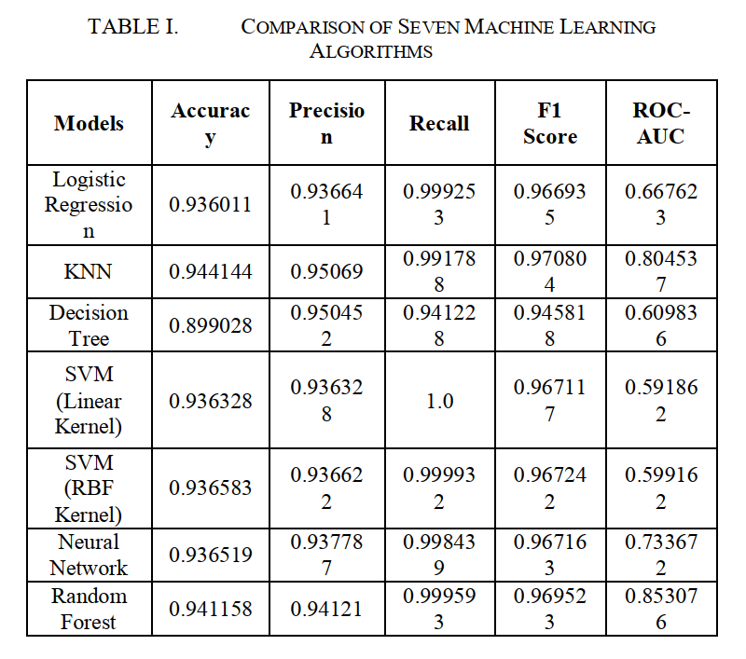
Results of the Original Study
Best Performing Models
K-Nearest Neighbors (KNN): Highest accuracy and strong balance across all metrics
Random Forest: Best ROC-AUC, highly precise and stable

Slide 4
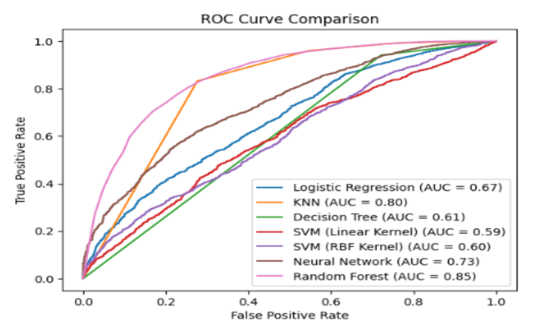
Results of the Original Study
Random Forest: Highest AUC → 0.853
KNN: AUC of 0.804
Logistic Regression & SVMs: Lower AUCs (~0.59–0.66)

Slide 5
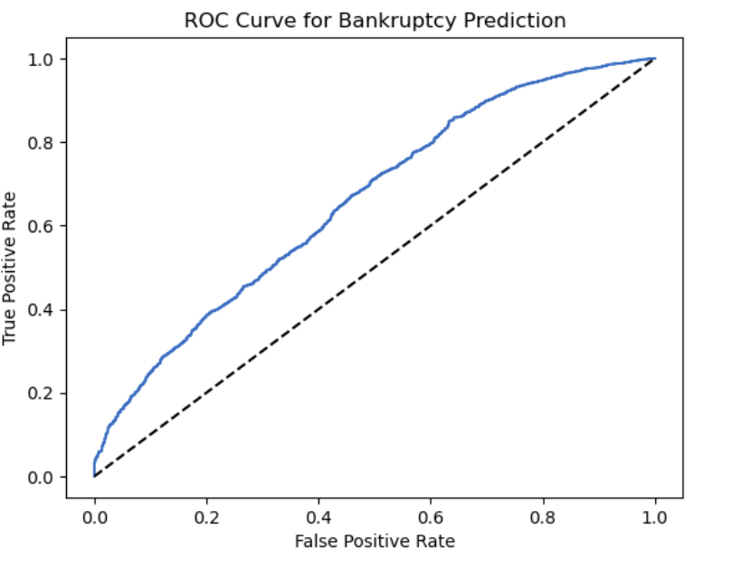
Logistic Regression – Model Evaluation
Model | Linear Regression
Accuracy | 0.9335
Precision | 0.9343
Recall | 0.9992
F1 Score | 0.9656
ROC-AUC | 0.6578

Slide 6
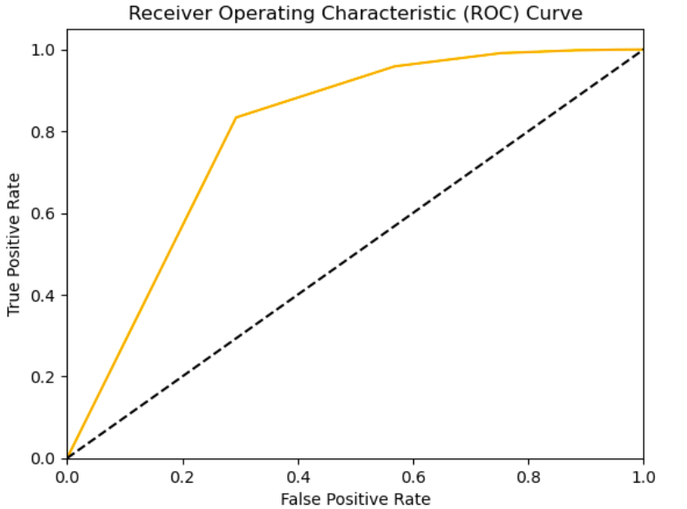
K-Nearest Neighbors (KNN) – Model Evaluation
Model | KNN
Accuracy | 0.9418
Precision | 0.9488
Recall | 0.9912
F1 Score | 0.9695
ROC-AUC | 0.7951

Slide 7
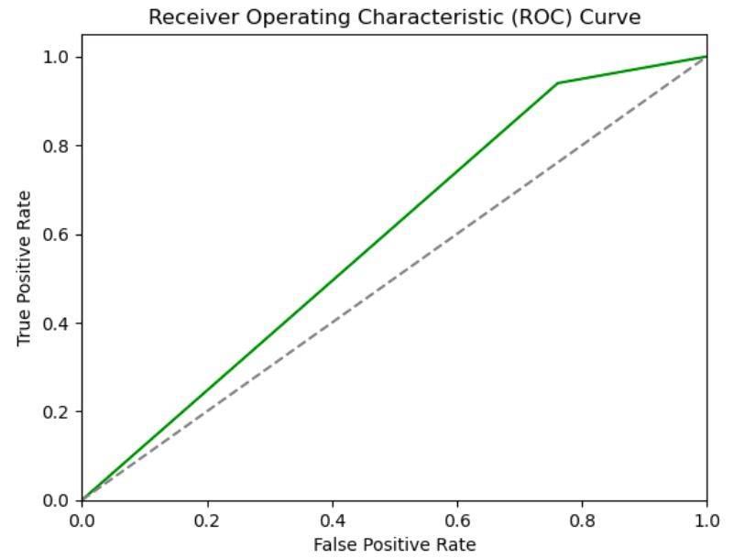
Decision Tree – Model Evaluation
Model | Decision Tree
Accuracy | 0.8923
Precision | 0.9443
Recall | 0.9399
F1 Score | 0.9421
ROC-AUC | 0.5893

Slide 8
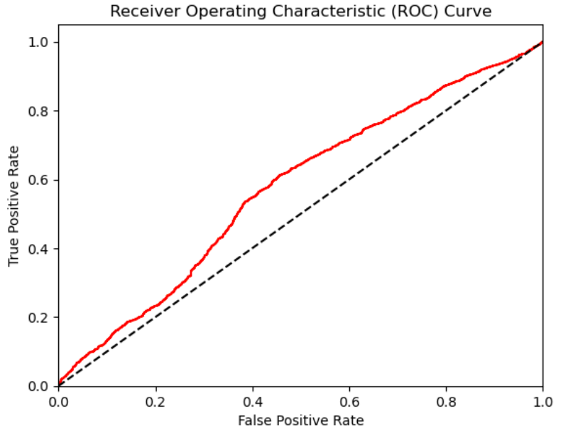
SVM (Linear Kernel) – Model Evaluation
Model | SVM(Linear Kernel)
Accuracy | 0.9321
Precision | 0.9321
Recall | 1.0
F1 Score | 0.9649
ROC-AUC | 0.5748

Slide 9
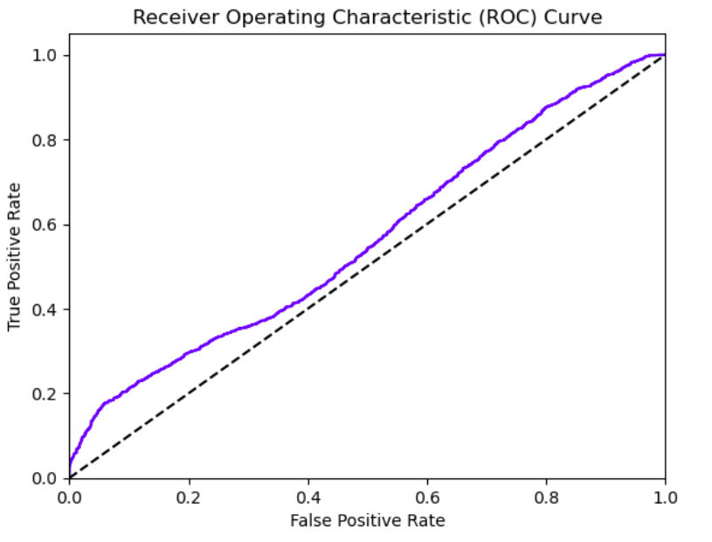
SVM (RBF Kernel) – Model Evaluation
Model | SVM (RBF Kernel)
Accuracy | 0.9325
Precision | 0.9324
Recall | 1.0
F1 Score | 0.9650
ROC-AUC | 0.5630

Slide 10
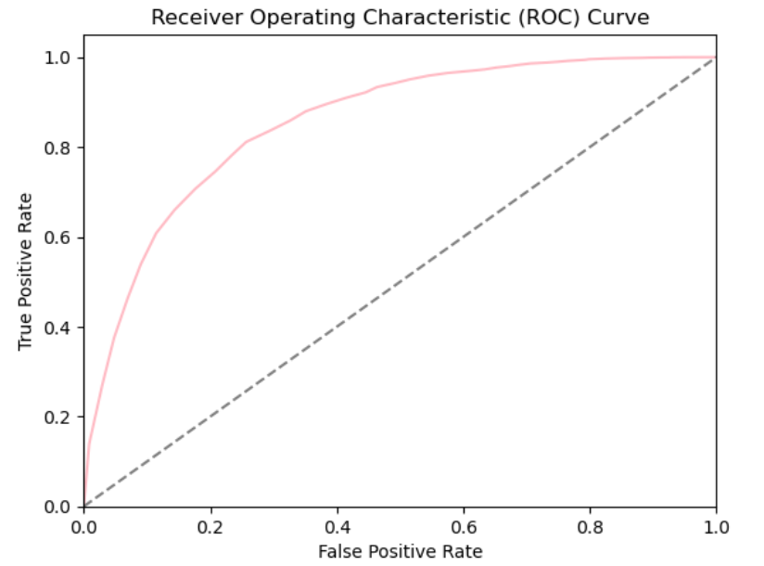
Random Forest – Model Evaluation
Model | Random Forest
Accuracy | 0.9364
Precision | 0.9364
Recall | 0.9996
F1 Score | 0.9669
ROC-AUC | 0.8541

Slide 11
Comparative Conclusion
Original Research Findings (IEEE 2024)
Best Model: K-Nearest Neighbors (KNN)
Top Accuracy: 94.41%
Random Forest showed strong performance with the highest ROC-AUC (85.31%)
SVMs and Logistic Regression had high recall but relatively lower ROC-AUC scores
Our Replication Findings
KNN replicated as the most accurate model, matching the research outcome
Random Forest consistently delivered the highest ROC-AUC, reinforcing its reliability.
Logistic Regression and SVMs maintained similar trends: high recall, weaker AUC
Consistency Across Metrics: Accuracy, recall, and AUC values followed the same patterns

Slide 12
Paper: Machine Learning Model for Detecting Money Laundering in Bitcoin Blockchain Transactions
Objective: Identify suspicious (money laundering) transactions
Dataset used in Paper: 2,906 instances from Kaggle, 24 attributes each.
Dataset adopted for our study: Elliptic Data Set (203768 instances, 167 attributes each)
Labels in Elliptic dataset: Illicit: 1, licit: 2, unknown: 0
Models used:
K-Nearest Neighbors
Random Forest (Implemented an Additional Model)

Slide 13
Results of the Original Study
KNN Model demonstrates high precision in flagging money laundering activity.
Low error rate of only 2%.
Techniques Used:
K-Means Clustering → Unsupervised grouping of transactions
K-Nearest Neighbors (KNN) → Classification based on clustering results
Model | KNN
Accuracy | 0.99
Precision | 0.97
Recall | 1.0
F-Score | 1.0
Error Rate | 0.020

Slide 14
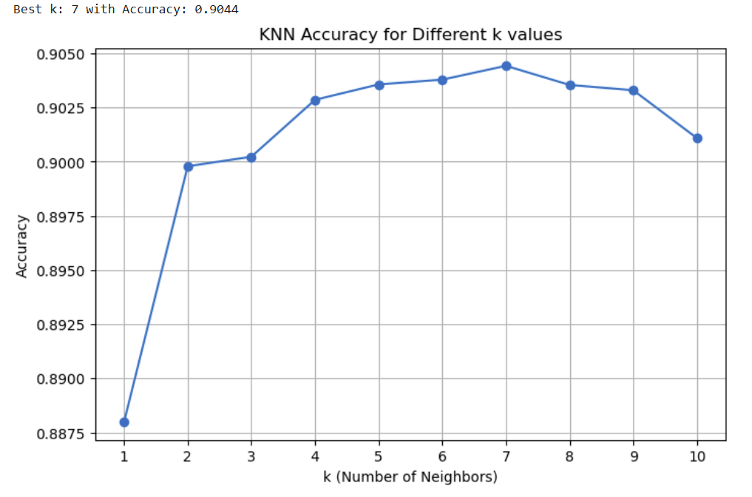
KNN Accuracy Evaluation
The accuracy steadily increased up to k = 7, where it peaked at 0.9044, indicating the best performance.
Beyond k = 7, the accuracy slightly declines, indicating potential over-smoothing.

Slide 15
Our Findings - Model Evaluation
Model | KNN | Random Forest
Accuracy | 0.9044 | 0.9509
Precision | 0.8202 | 0.9429
Recall | 0.7431 | 0.8434
F1 Score | 0.7764 | 0.8864
Error Rate | 0.0955 | 0.0490
Random Forest model outperformed KNN, achieving the highest accuracy at 95.09% and the lowest error rate at 4.90%.
KNN also demonstrated strong performance with an accuracy of 90.44%.
Random Forest is highly effective for high-dimensional classification tasks

Slide 16
Comparative Conclusion
Original Study (JAAI 2024 - Ogunleye et al.):
Models Used:
Unsupervised: K-Means (to label data)
Supervised: K-Nearest Neighbors (KNN) only
KNN was reported to be extremely accurate and robust.
Our Replication Findings:
Using a much larger dataset, our replication suggests the superior performance of Random Forest, with the highest accuracy (0.9509) and lowest error rate (0.0490).
KNN also performed well with 0.9044 accuracy closely aligning with the original study.

Slide 17
References
Ogunleye, O. S., Oyelade, O. N., & Adebayo, S. O. (2024). Machine Learning Model for Detecting Money Laundering in Bitcoin Blockchain Transactions. Journal of Advanced Artificial Intelligence (JAAI), 12(3), 144–159.
Vandana. (2012). Machine Learning Techniques for Financial Fraud Detection: A Review. International Journal of Computer Applications, 45(21), 25–30.
IEEE (2024). Cognitive Modelling of Bankruptcy Risk Using Machine Learning Algorithms. Proceedings of the IEEE Conference on Cognitive Computing, pp. 101–110.
Kaggle. (n.d.). US Company Bankruptcy Prediction Dataset. Retrieved from: https://www.kaggle.com/datasets/utkarshx27/american-companies-bankruptcy-prediction-dataset4
Elliptic. (2020). Elliptic Dataset for Bitcoin Money Laundering Detection. Retrieved from: https://www.kaggle.com/code/smlopezza/elliptic-data-set-eda-graphs-random-forest/input?select=elliptic_bitcoin_dataset

